Slide 1
IBM Rational Rhapsody Advanced Systems Training v7.5
Documenting Models

Slide 2
Objectives
In this module you will learn:
  How to generate basic reports from Rhapsody models.
  How to generate more advanced reports using Rhapsody ReporterPLUS.
  How to define your own templates for report generation.
    Note that this is an introduction only – a full Rhapsody Reporter class is available for further training.

Slide 3
Documentation generation overview
When producing reports from Rhapsody there are two options available.
Report on Model
  This option generates an rtf document.
  Very little control over content or formatting.
  Can be useful as a ‘working document’
Rhapsody Reporter Plus
  Documents are generated based on customizable templates.
  This is the recommended option for report generation.

Slide 4
Report on Model
IBM Rational Rhapsody Advanced Systems Training v7.5

Slide 5
Open a model
Launch Rhapsody.
From the menu:
  File > Open
Open the FillingStation9 model.

Slide 6
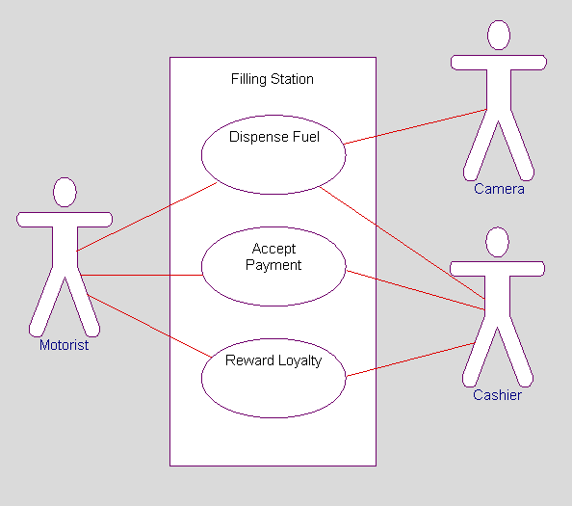
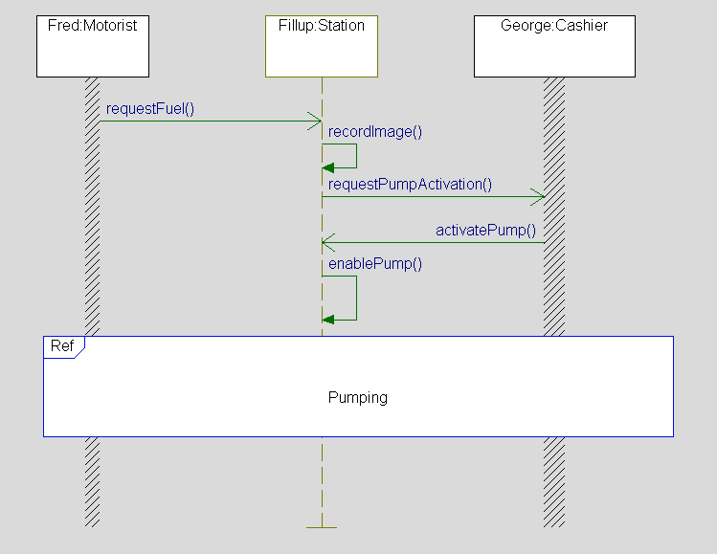
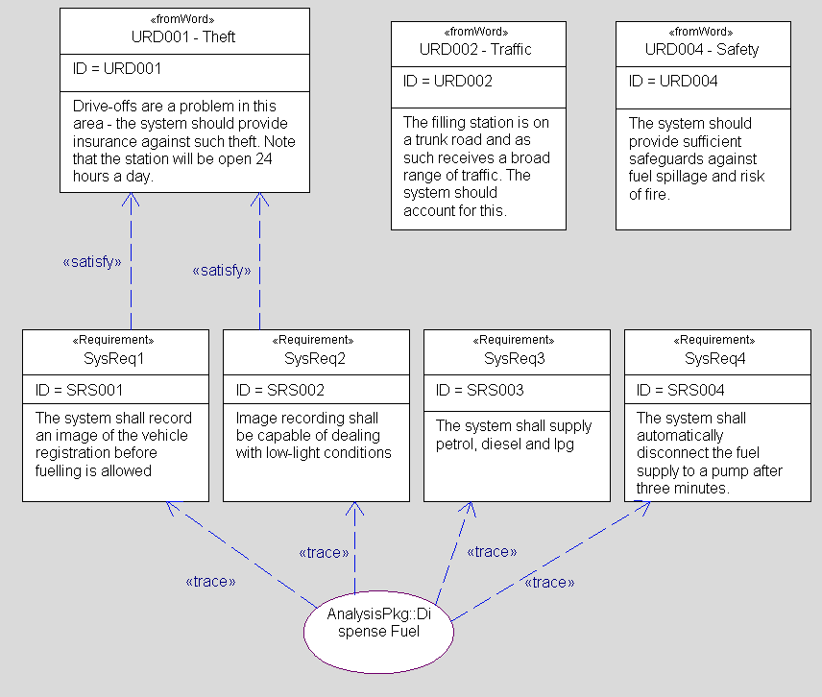
Model overview
Review the model briefly:
  This is the model built in the Essentials of IBM Rational Rhapsody for Systems Engineers training class.

Slide 7
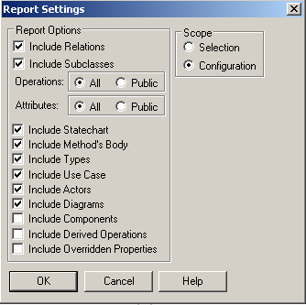
Generate a report
From the menu:
  Tools > Report on Model.
  Select Include Diagrams.
  Click OK.

Slide 8
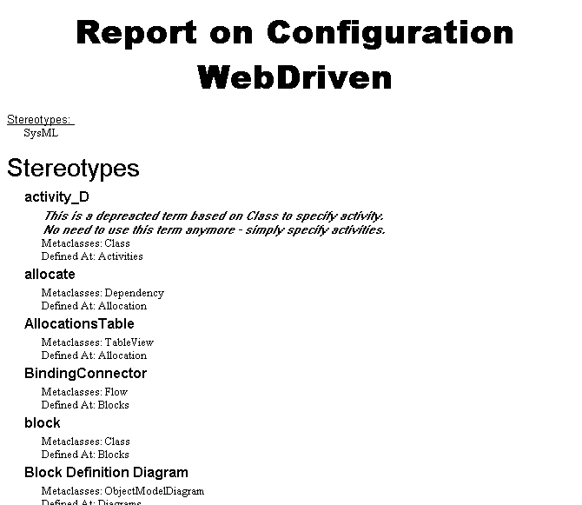
The generated report
The generated rtf document opens in Rhapsody.
  The report is Temporary – when its closed in Rhapsody – its deleted from the hard drive.
  To retain it – open the project directory and rename the report before closing it in Rhapsody.
The report generation is very quick, but there is little control over the formatting.

Slide 9
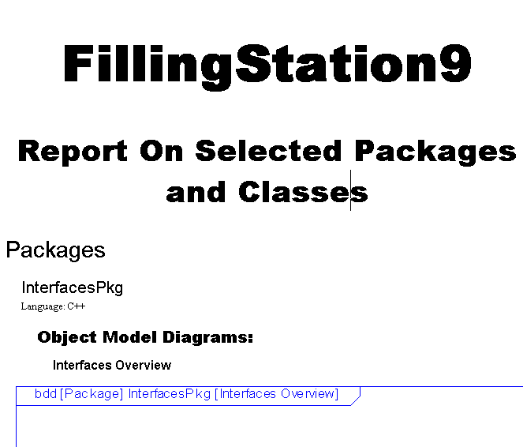
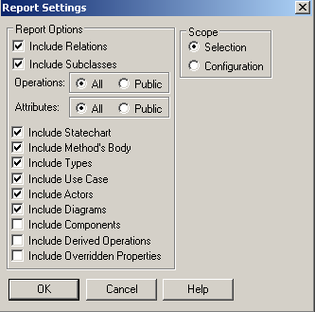
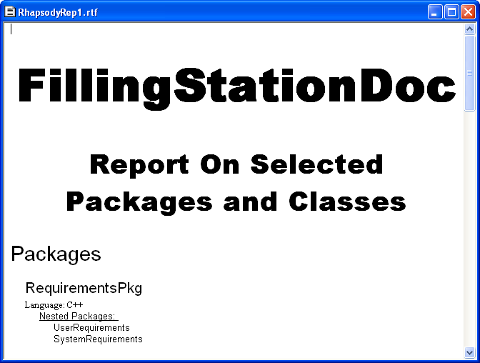
Generate a scoped report
In the browser, select the InterfacesPkg.
From the menu:
  Tools > Report on Model.
  Select Selection as the Scope.
  Click OK.
A report is produced for the RequirementsPkg only

Slide 10
Rhapsody ReporterPLUS
IBM Rational Rhapsody Advanced Systems Training v7.5

Slide 11
ReporterPLUS overview
ReporterPLUS can generate documentation in several formats:
  HTML
  RTF
  Word
  Plain text
  Microsoft PowerPoint.
Reports are based on templates.
  Predefined templates are included in the Rhapsody install.
  You may create your own templates or customize existing templates

Slide 12
IBM Rational Rhapsody Advanced Systems Training v7.5
Rhapsody ReporterPLUS - Generating a Report in Microsoft Word

Slide 13
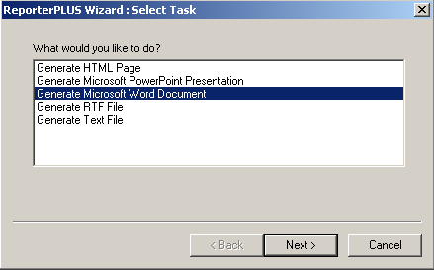
Generate a report from an existing template
Close any open RTF documents.
From the menu, select:
  Tools > ReporterPLUS > Report on all model elements
Rhapsody invokes a report generation wizard.
  Select Generate Microsoft Word Document.
  Click Next.

Slide 14
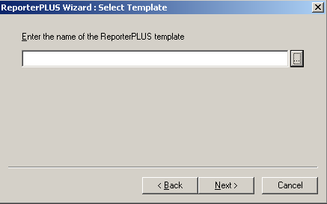
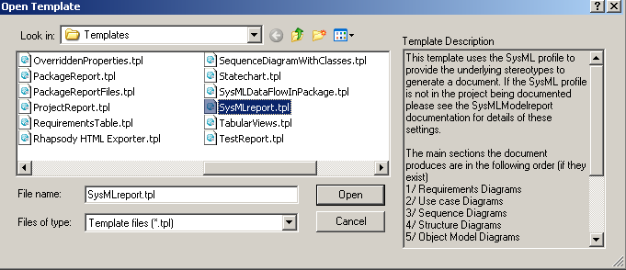
Select a template
When you are asked to select a template, click the browse button.
Browse to:
  RhapsodyInstall\reporterplus\Templates
  Select SysMLreport
  Click Open.
  Click Next.
Browse for a template

Slide 15
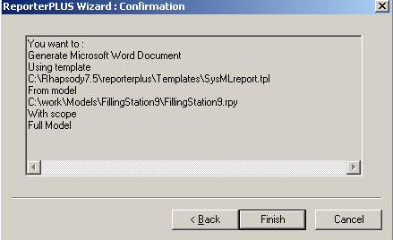
Confirm report generation
Click Finish to confirm report generation.

Slide 16
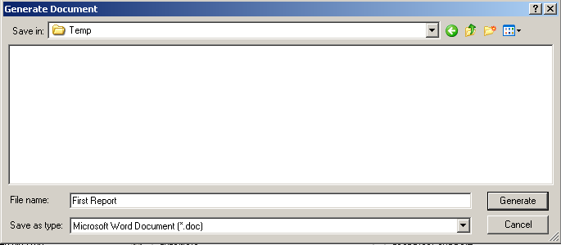
Choose a location and a name
In the Generate Document dialog:
  Browse to the folder where you want to place the report.
  Name the report First Report.
  Click Generate.
Choose folder
Report name

Slide 17
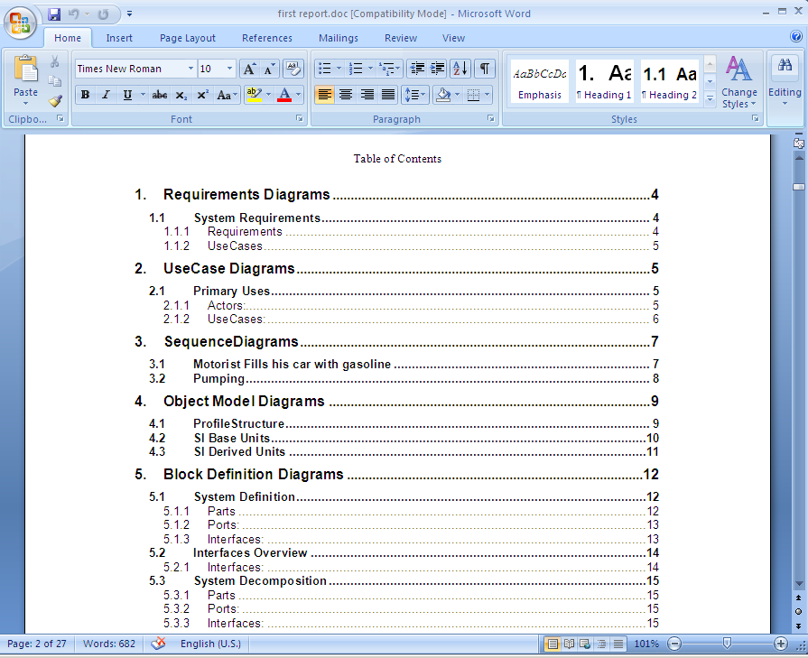
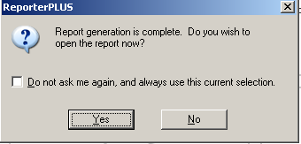
Open the report
ReporterPLUS examines the model and template and generates the report.
  Click Yes to open the report in Microsoft Word.
  View the report and then close it.

Slide 18
IBM Rational Rhapsody Advanced Systems Training v7.5
Generating a Report in HTML

Slide 19
Generating HTML reports
Reports may be generated in HTML format.
  Using the same templates that you used to generate Word documents.
  Using a specific template designed for HTML that replicates the Rhapsody browser.
Generated documents may be placed on an intranet site for browsing.
You will now generate a report that replicates the Rhapsody browser in an HTML web page.
  Note that this particular template takes significantly longer to produce a report than any of the basic templates.

Slide 20
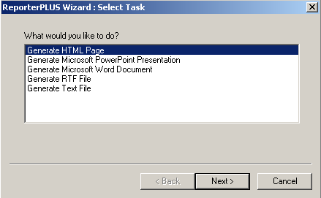
Generate a report from an existing template
From the menu, select:
  Tools > ReporterPLUS > Report on all model elements
Rhapsody invokes a report generation wizard.
  Select Generate HTML Page.
  Click Next.

Slide 21
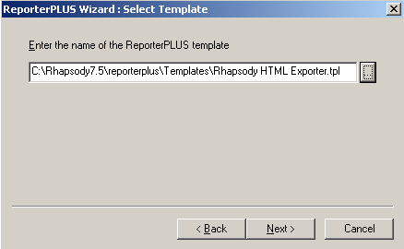
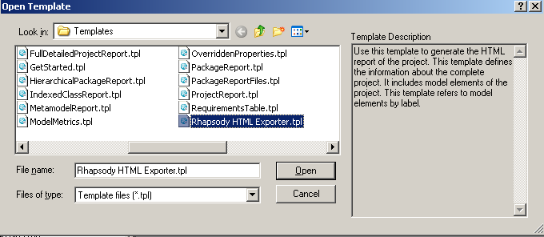
Select a template
Click the browse button.
Browse to:
  RhapsodyInstall\reporterplus\Templates
  Select Rhapsody HTML Exporter
  Click Open.
  Click Next.
Browse for a template

Slide 22
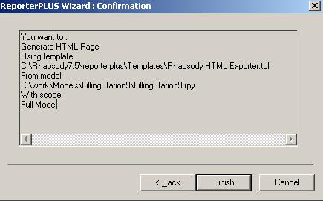
Confirm report generation
Click Finish to confirm report generation.

Slide 23
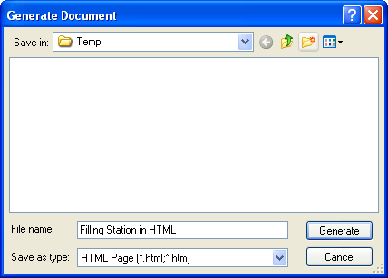
Choose a location and a name
In the Generate Document dialog:
  Browse to the folder where you want to place the report.
  Name the report Filling Station in HTML.
  Click Generate.
Choose folder
Report name

Slide 24
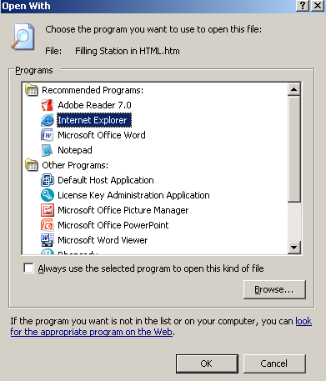
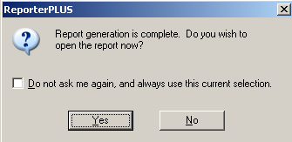
Open the report
ReporterPLUS examines the model and template and generates the report.
  Click Yes to open the report in Internet Explorer.
  You may need to allow blocked content

Slide 25
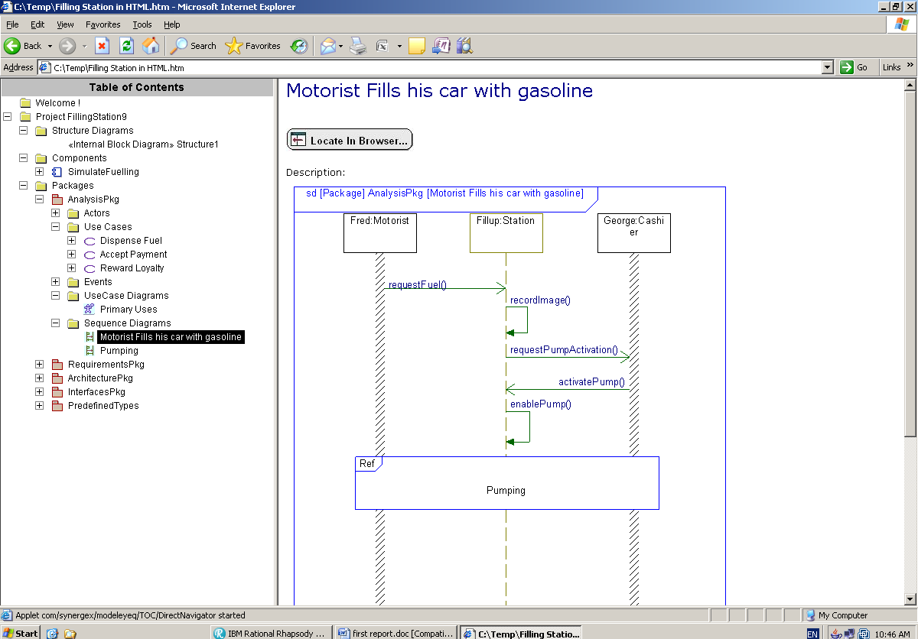
Rhapsody in HTML

Slide 26
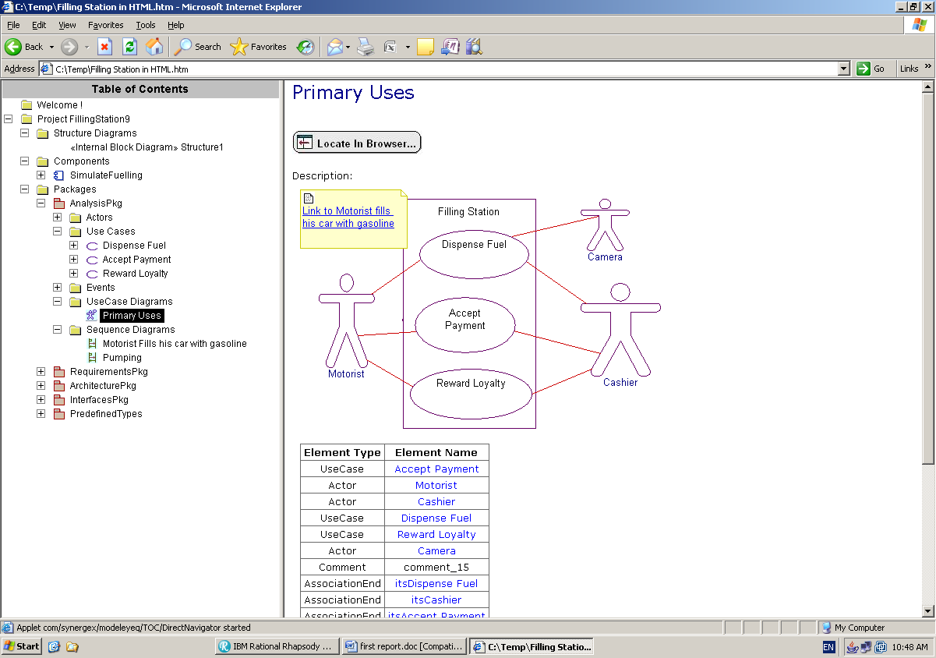
Browsing
Locate in Browser works just as it does in Rhapsody
Browse as you would in Rhapsody
Some elements are automatically hyperlinked

Slide 27
Making diagrams live
In the HTML report diagrams are static images.
  Clicking on items inside the diagram won’t work
However ReporterPLUS can be configured to create diagrams as live images
  Items on the diagram become independently ‘clickable’
  Configuration requires adding an entry in the rhapsody.ini file
  It is not enabled by default since it does increase the report generation time significantly.
  Details are given on the next few slides
    However if you choose to test this please remove the entry afterwards – future courses may use the same machine

Slide 28
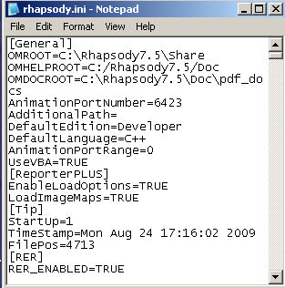
Configuring ReporterPLUS for live images
First close Rhapsody
  Configuration requires modification of the rhapsody.ini file
  When Rhapsody closes it replaces the rhapsody.ini file with an updated version containing project history.
Edit the rhapsody.ini file in a text editor
  C:\Rhapsody\rhapsody.ini
Add the following section:
  [ReporterPLUS]
  EnableLoadOptions=TRUE
  LoadImageMaps=TRUE

Slide 29
Generate a report
Load Rhapsody.
Open the FillingStation9 project.
In the Browser select the Analysis package
From the menu, select:
  Tools > ReporterPLUS > Report on selected package.
  Generate a report using the HTML Exporter template.
  Reporting only on a specific package will reduce the time it takes to generate the report.
    However the actual template itself is very complex and will take some time to load – regardless of model size or report scope.

Slide 30
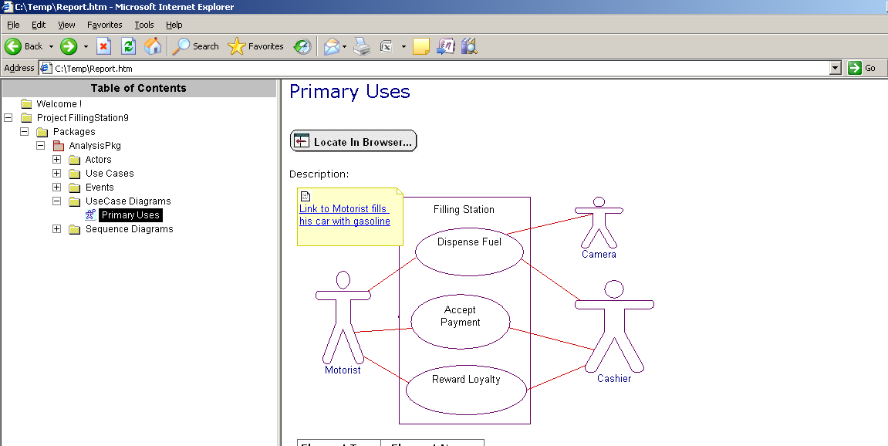
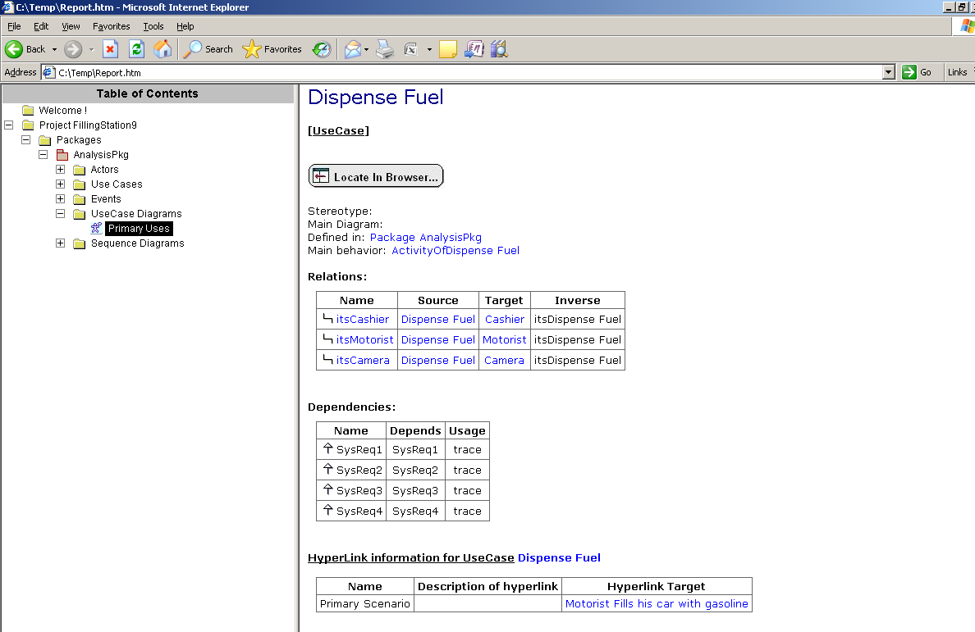
Hyperlinked diagrams
This time in the generated report:
Clicking Here …
Takes you here

Slide 31
IBM Rational Rhapsody Advanced Systems Training v7.5
Rhapsody ReporterPLUS - Creating a Template

Slide 32
Introduction
You may create your own templates using ReporterPLUS
  Templates are created using a graphical tool.
  Templates may be as simple as drag and drop.
  Templates may be much more intelligent using a built in query language
  Templates may be generic (will run on any model) or specific (designed for a specific model)
You will now learn how to create a basic template in ReporterPLUS

Slide 33

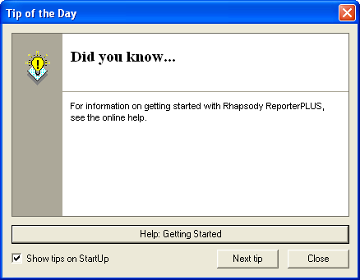
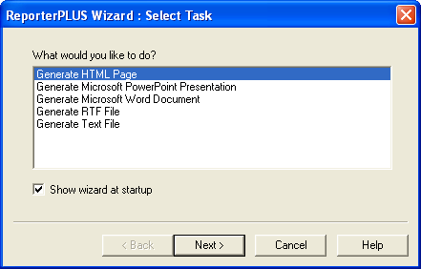
Launch the editor
From the menu, select:
  Tools > ReporterPLUS > Create/Edit template with ReporterPLUS
  Click Close to close the tip of the day.
  Click Cancel to cancel the Wizard.

Slide 34
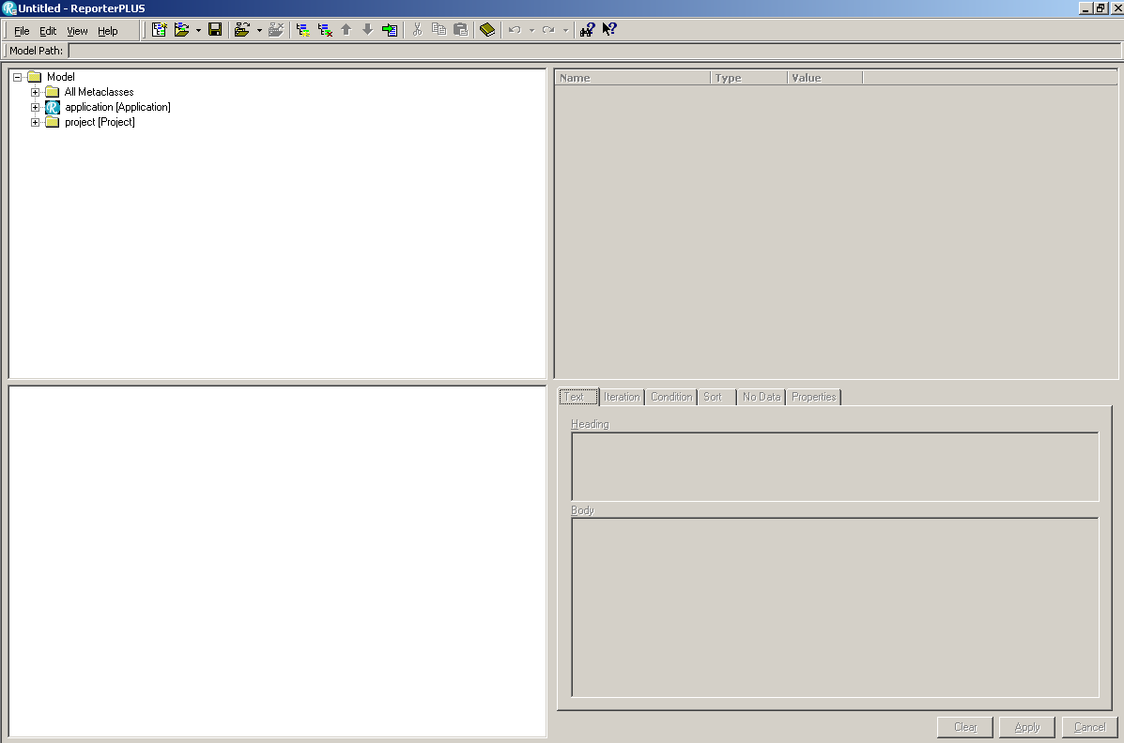
The editor layout
Attribute View
Shows attributes of the selected model element that may be included in the report
Model View
Shows model structure & elements
Template View
Shows the structure of the template
Template Node View
Shows the details of the selected item in the template view

Slide 35
Specific templates
As previously discussed, templates may be:
  Generic
  Specific
When creating a specific template the Rhapsody model may be loaded into the report editor
  Specific model elements may then be dragged into the template
  This is also a useful way to learn the structure of a document before creating a more generic one

Slide 36
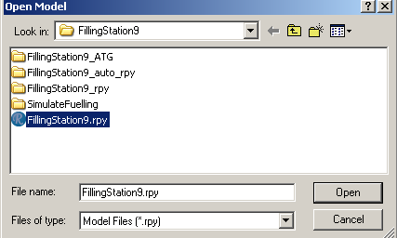
Load a model
Load the Filling Station model into the report editor:
  From the menu, select File > Open Model.
  Browse to the FillingStation9 folder.
  Select FillingStation9.rpy
  Click Open.

Slide 37
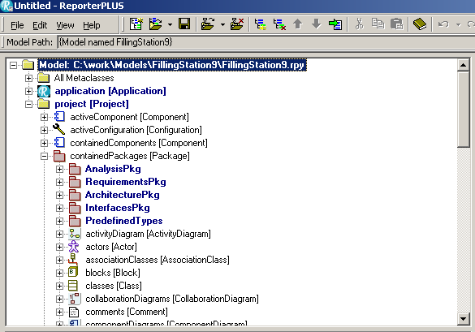
The model view
The model view now shows:
  The structure of a generic model
  Actual model elements from the loaded model.
A project has contained packages
The loaded project has these specific contained packages
Model View
Attribute View
Template View
Template Node View

Slide 38
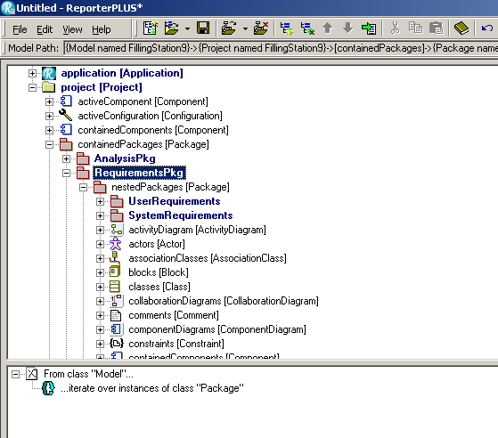
Dragging specific elements
Expand the RequirementsPkg
  Expand the nestedPackages node
  Drag the SystemRequirements package from the model view to the template view.
Model View
Attribute View
Template View
Template Node View

Slide 39
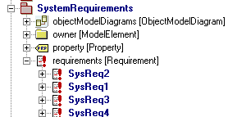
Package content
In the model view:
  Expand the SystemRequirements package node.
  Expand the requirements node.
Packages contain requirements
The SystemRequirements package contains these specific requirements
Model View
Attribute View
Template View
Template Node View

Slide 40
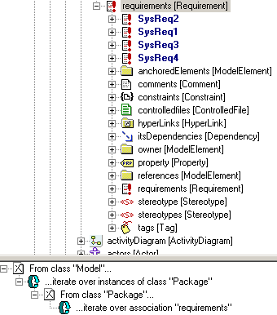
Further template structure
Drag the requirements node from the model view to the template view
  Rather than dragging each specific requirement – this part of the template will be generic and will extract all requirements in the package
  Drag the requirements node onto the last sub-node in the template
    Thereby building a structure
Model View
Attribute View
Drag it onto this node
Template View
Template Node View

Slide 41

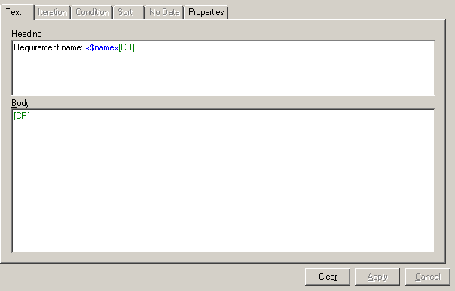
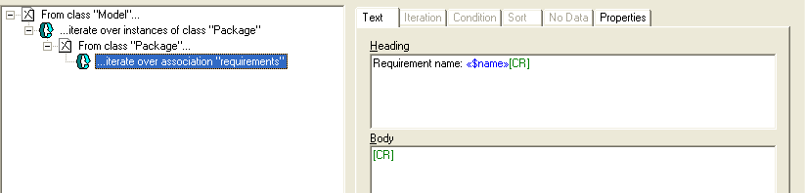
Boilerplate text
In the template view:
  Select the last node in the structure
In the template node view:
  Note the content of the report
Model View
Attribute View
Template View
Template Node View
Attributes will be automatically replaced when the report is generated
Boilerplate text will appear in the report exactly as it does in the template

Slide 42
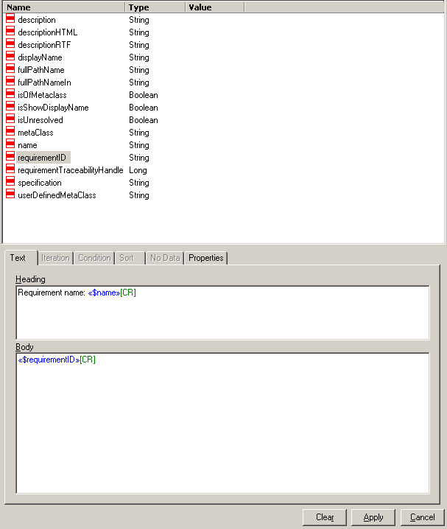
Attributes - requirementID
In the model view, select the requirements node.
  All attributes of a requirement appear in the attribute view.
  Drag the requirementID attribute from the attribute view to the template node view
    Drag it into the
    Body section.
Model View
Attribute View
Template View
Template Node View

Slide 43
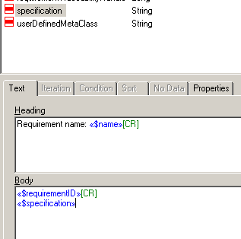
Attributes - requirementID
Drag the specification attribute to the template node view
  When the report is generated, these attributes will be automatically replaced with actual values from the model.

Slide 44

Adding commands
To insert a carriage return after the specification attribute:
  Left click inside the body field to place the cursor
    Place it at the end of the specifications attribute
  Right-click and select:
    Commands > Add Carriage Return
  Click Apply

Slide 45
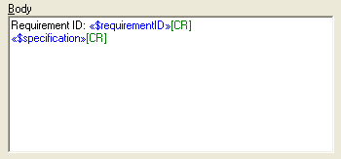
Add boilerplate text
Left-click inside the Body field
  Add some boilerplate text:

Slide 46
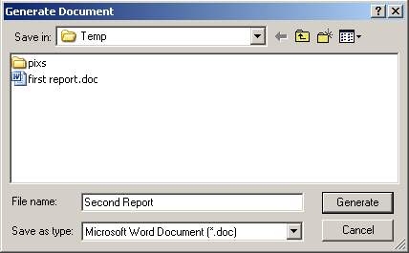
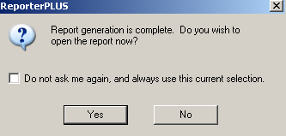
Generate a document
On the toolbar:
  Click the Generate Document button
  Browse to the folder where the report should be generated.
  In the Save as type field, select Microsoft Word Document.
  Name the document Second Report.
  Click Generate.
  Examine your report. Close the report.

Slide 47
Summary
You have now learned:
  How to generate basic reports from Rhapsody models.
  How to generate more advanced reports using Rhapsody ReporterPLUS.
  How to define your own templates for report generation.
    Creating detailed templates can be a complex job.
    Further ReporterPLUS training is available.
      It is highly recommended that anyone responsible for creating documentation templates attend this course.
    Consultancy is also available.

